Slide 1

EN.580.428 Genomic Data Visualization Lesson 3 Review
Prof. Jean Fan

Slide 2
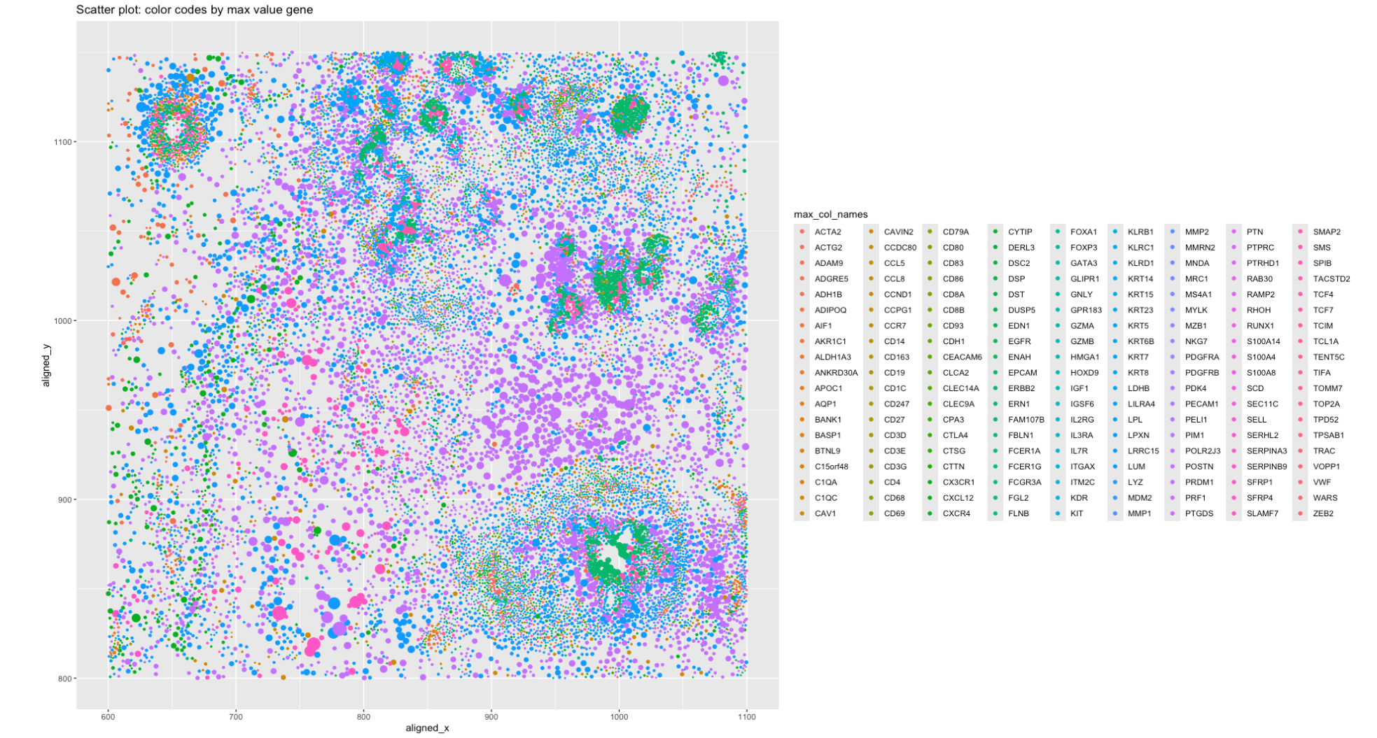

Slide 3
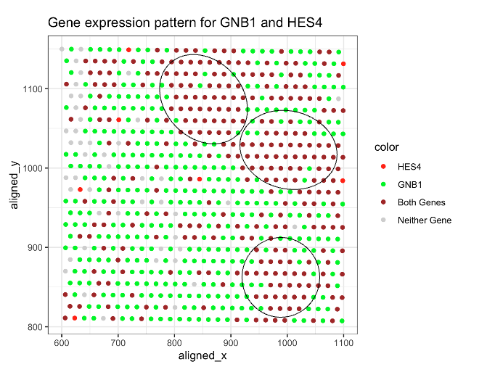

Slide 4
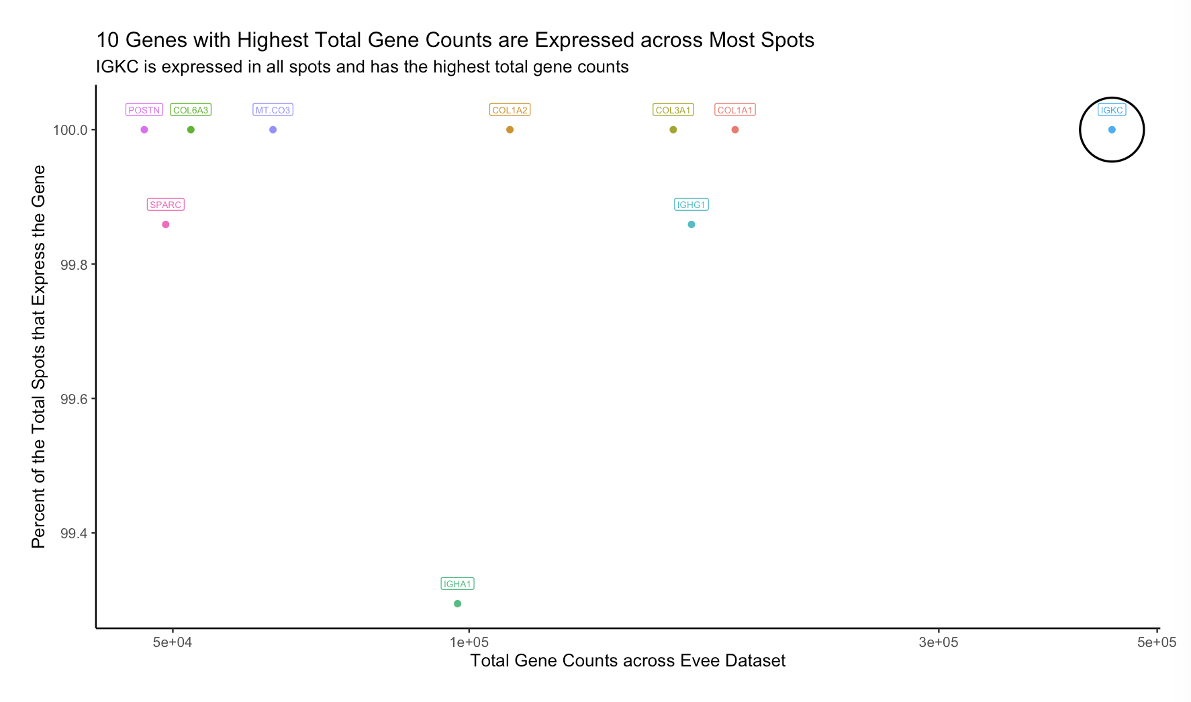

Slide 5
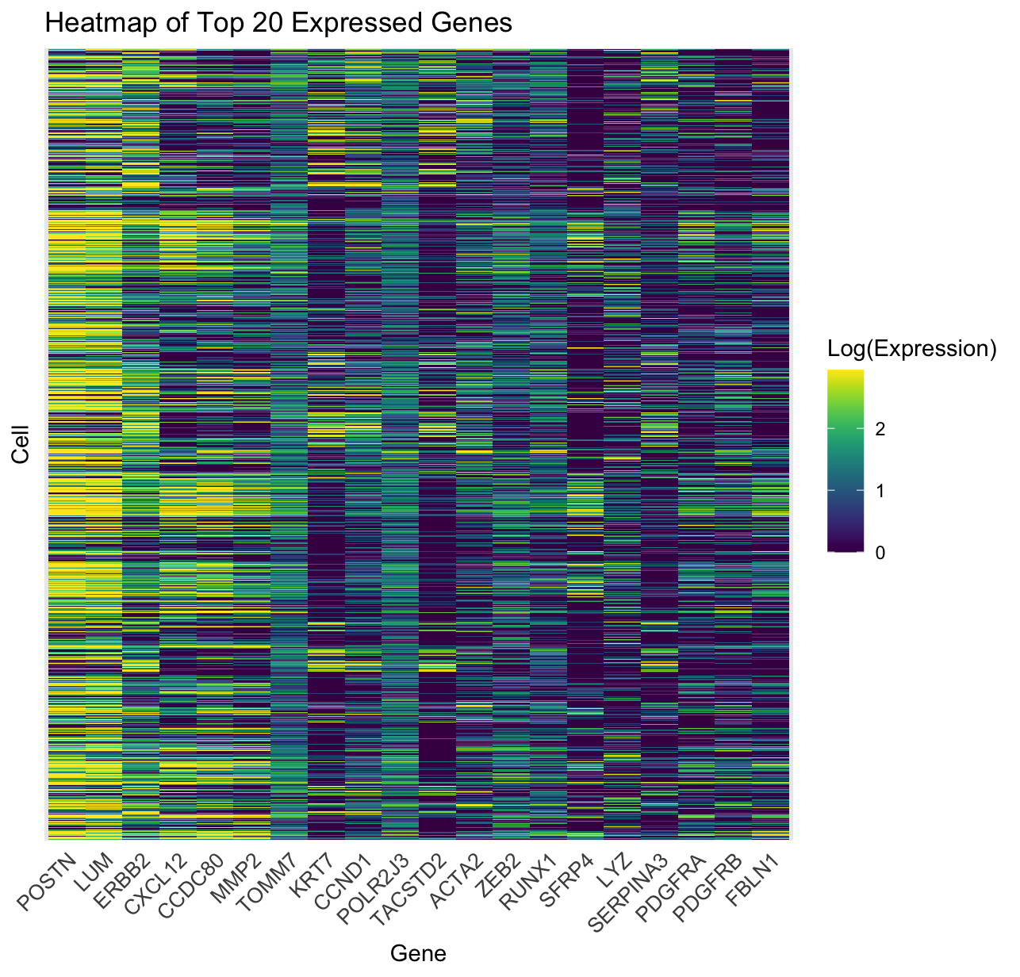

Slide 6
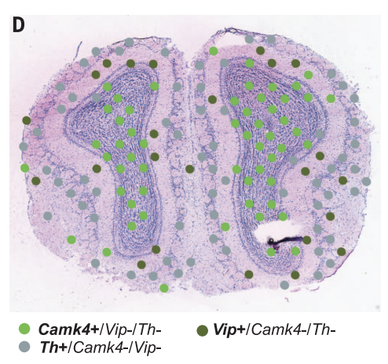
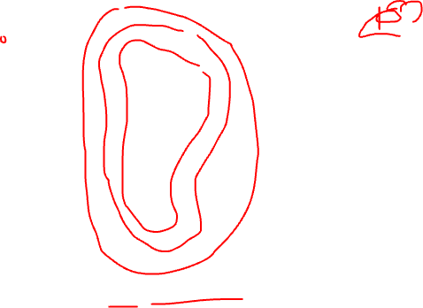
Published figures visualizing multiple genes at once with spatial context
(Stahl et al, 2018)

Slide 7
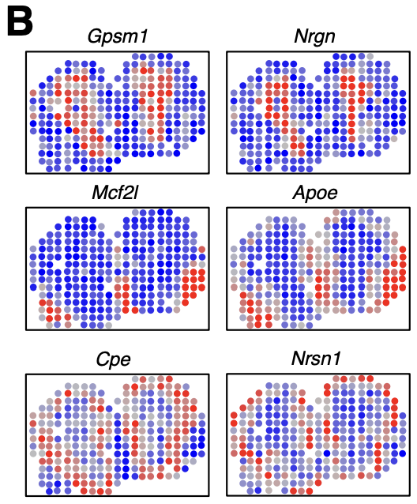
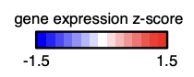
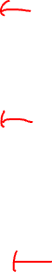
Published figures visualizing multiple genes at once with spatial context
(Miller et al, 2021)

Slide 8
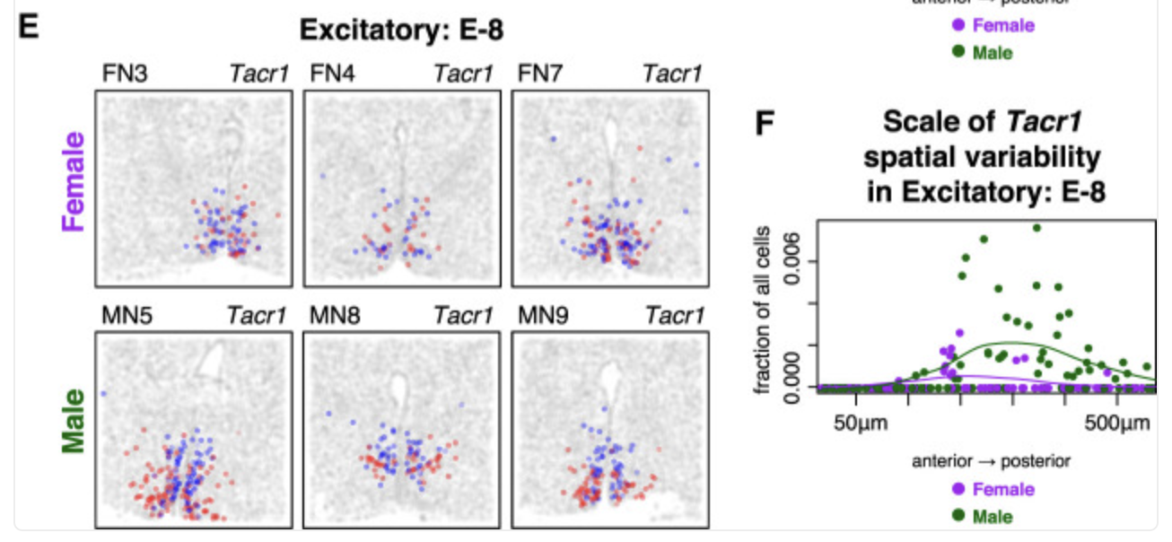
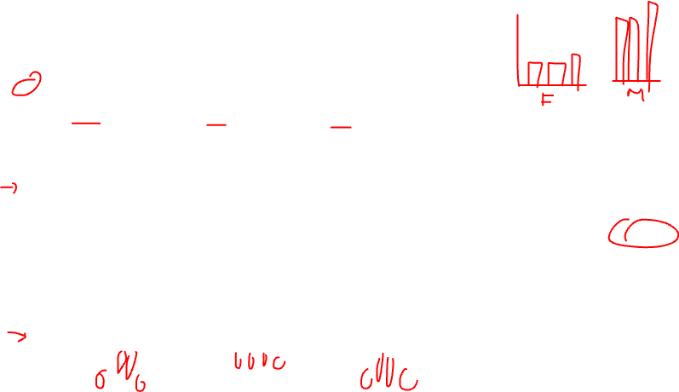
Published figures visualizing trends in gene expression with summary statistics
(Miller et al, 2021)

Slide 9
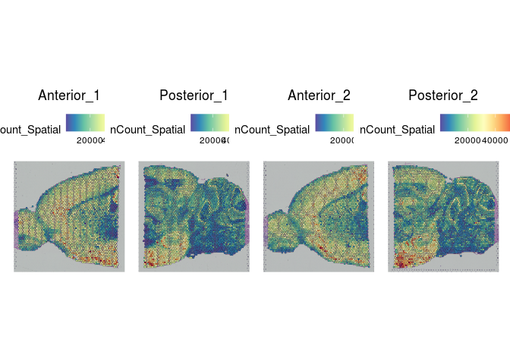
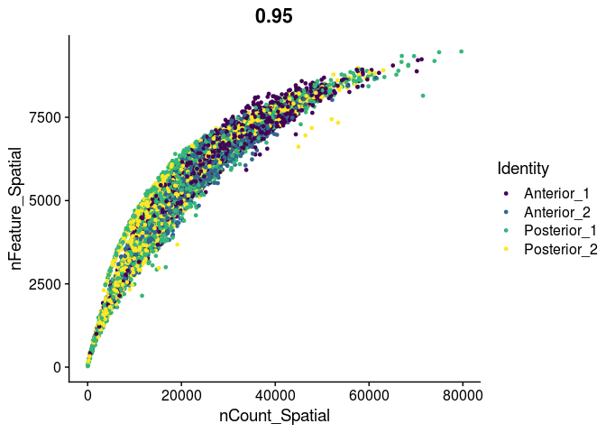
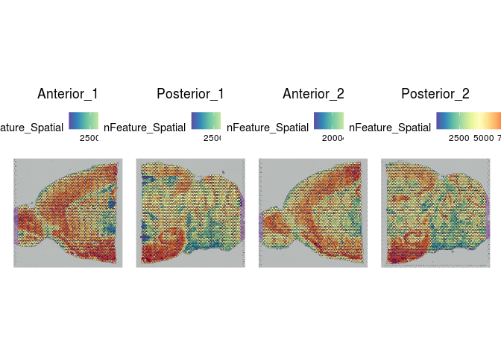

Published figures visualizing trends in gene expression with summary statistics
https://ucdavis-bioinformatics-training.github.io/2022-December-Spatial-Transcriptomics/data_analysis/spatial_analysis

Slide 10
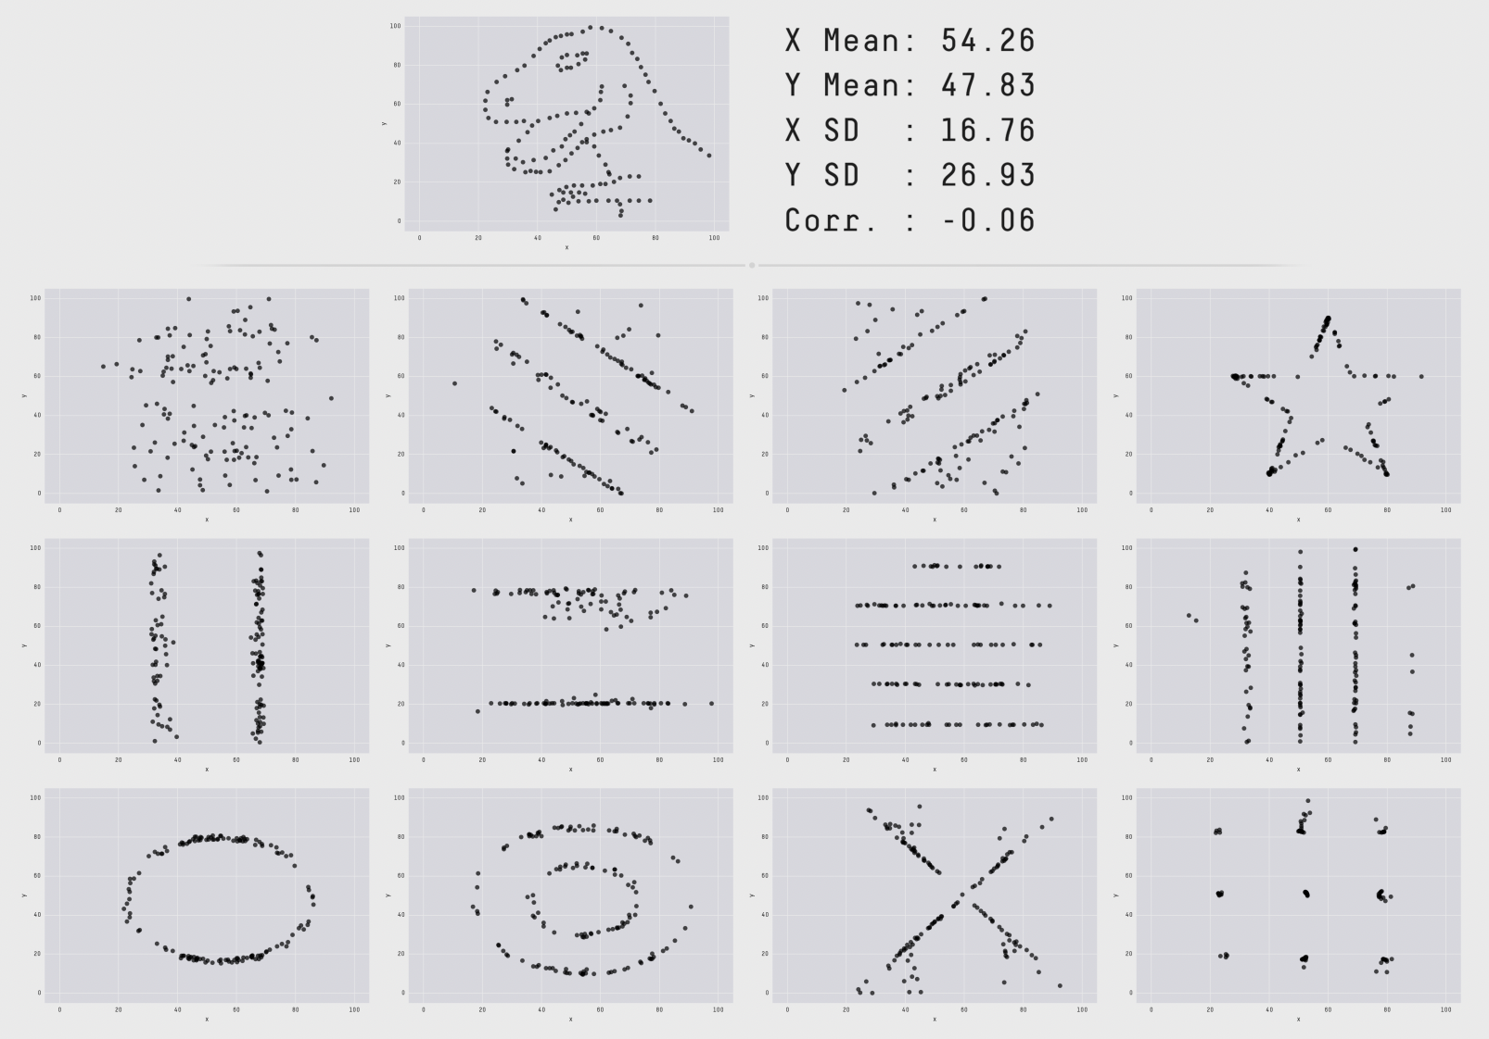

How does data visualizations work?
Visualization uses perception to free up cognition
Trends, gaps, outliers, clusters
Confirm, explore, present information
https://www.research.autodesk.com/publications/same-stats-different-graphs/

Slide 11
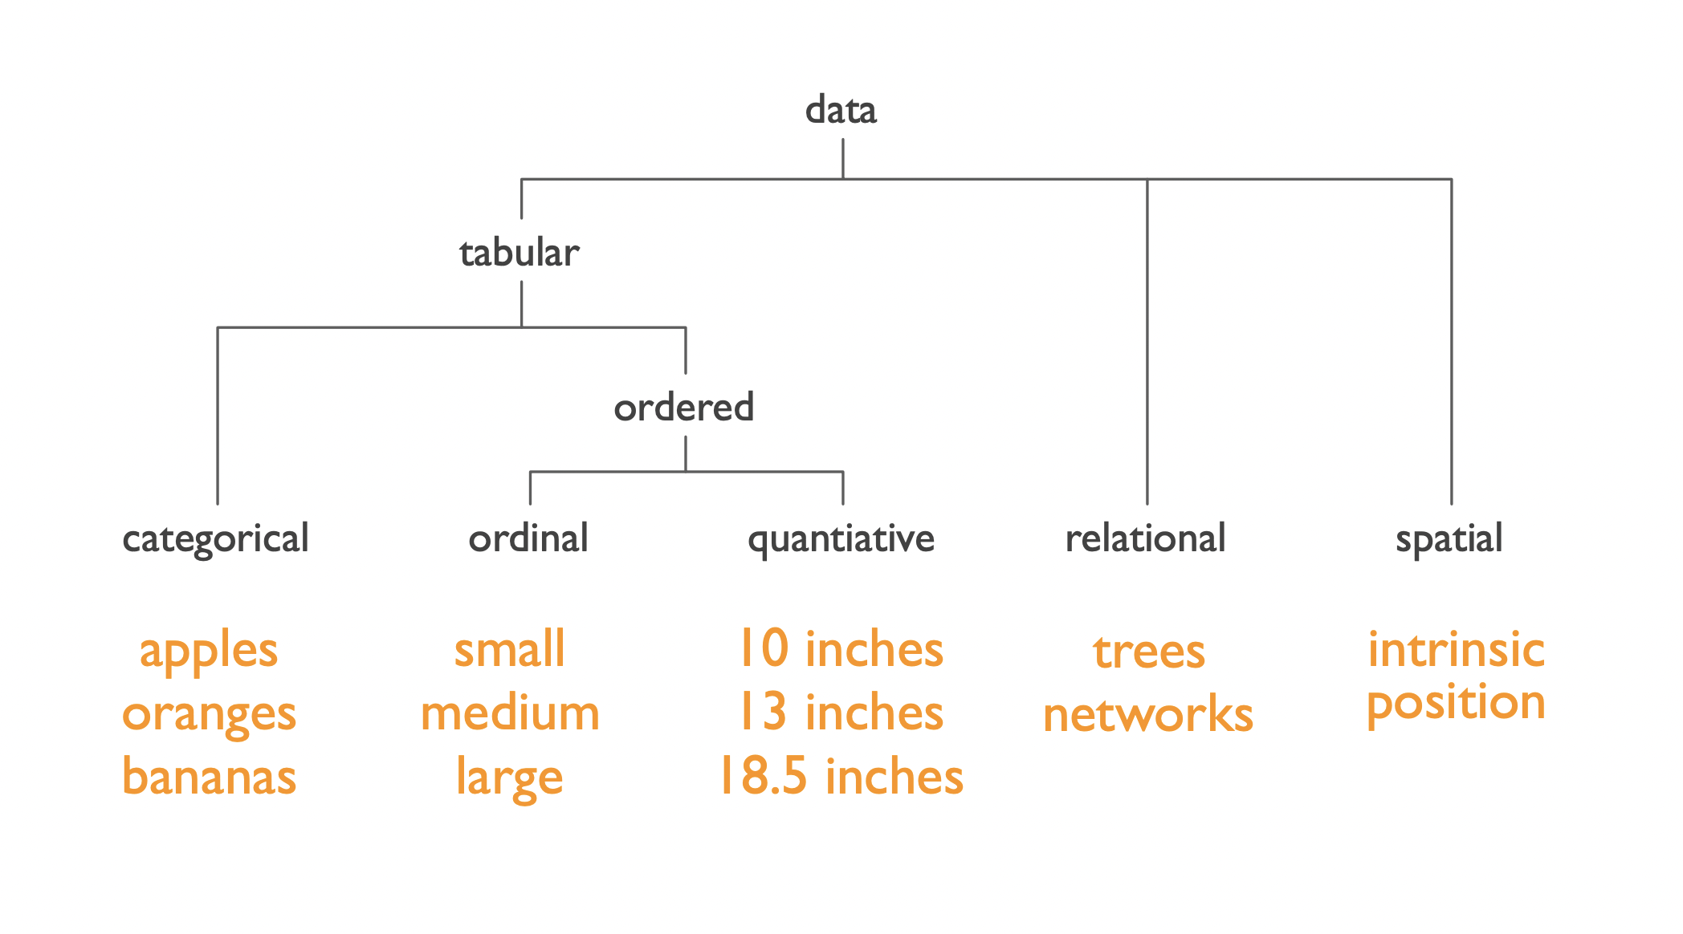
Data types

Slide 12
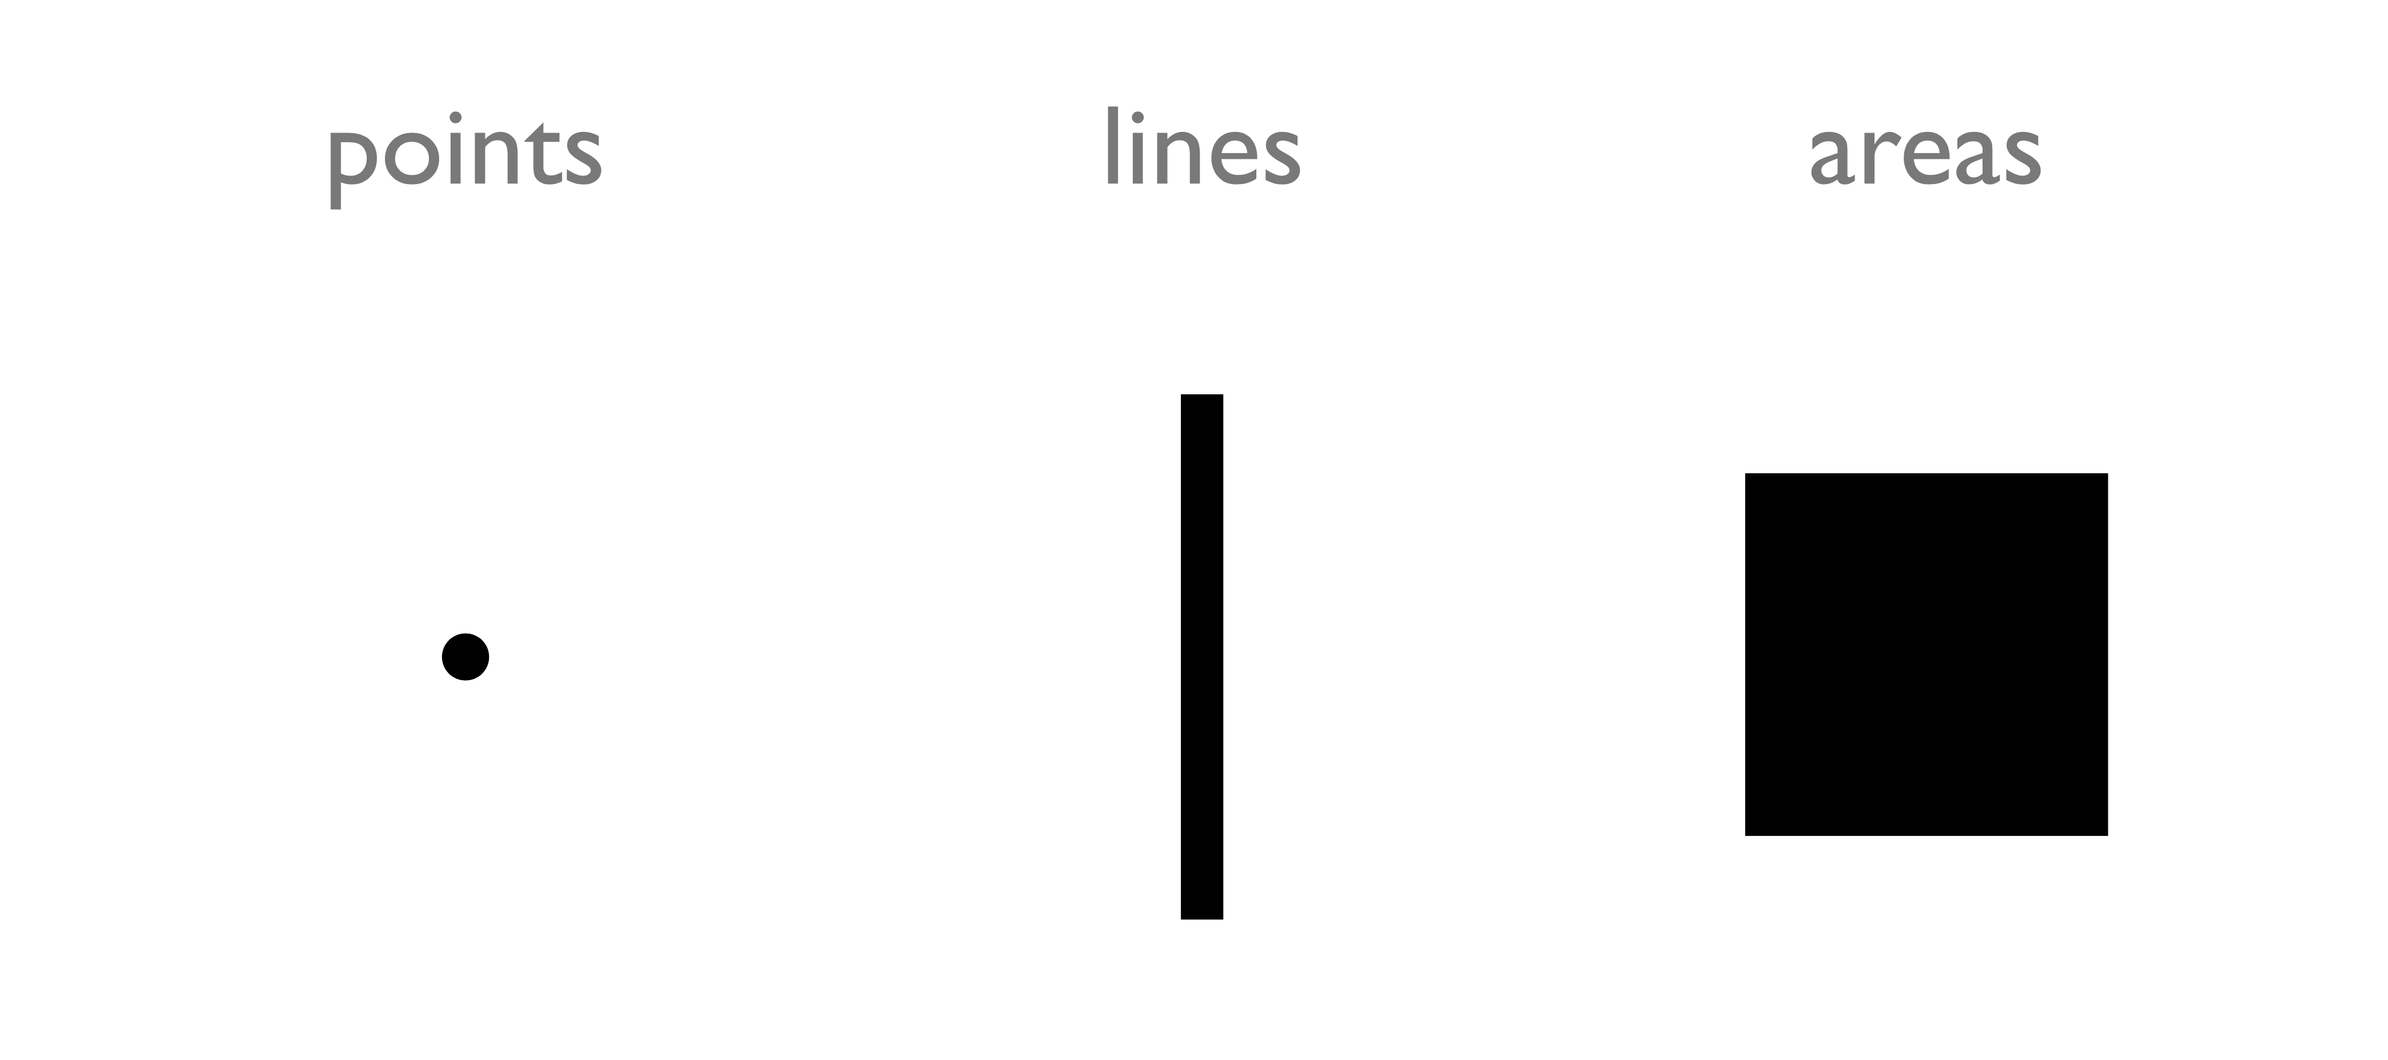
Types of encodings for different data types: Geometric Primitives
(Credit: Nils Gehlenborg, ISMB/ECCB 2011)

Slide 13
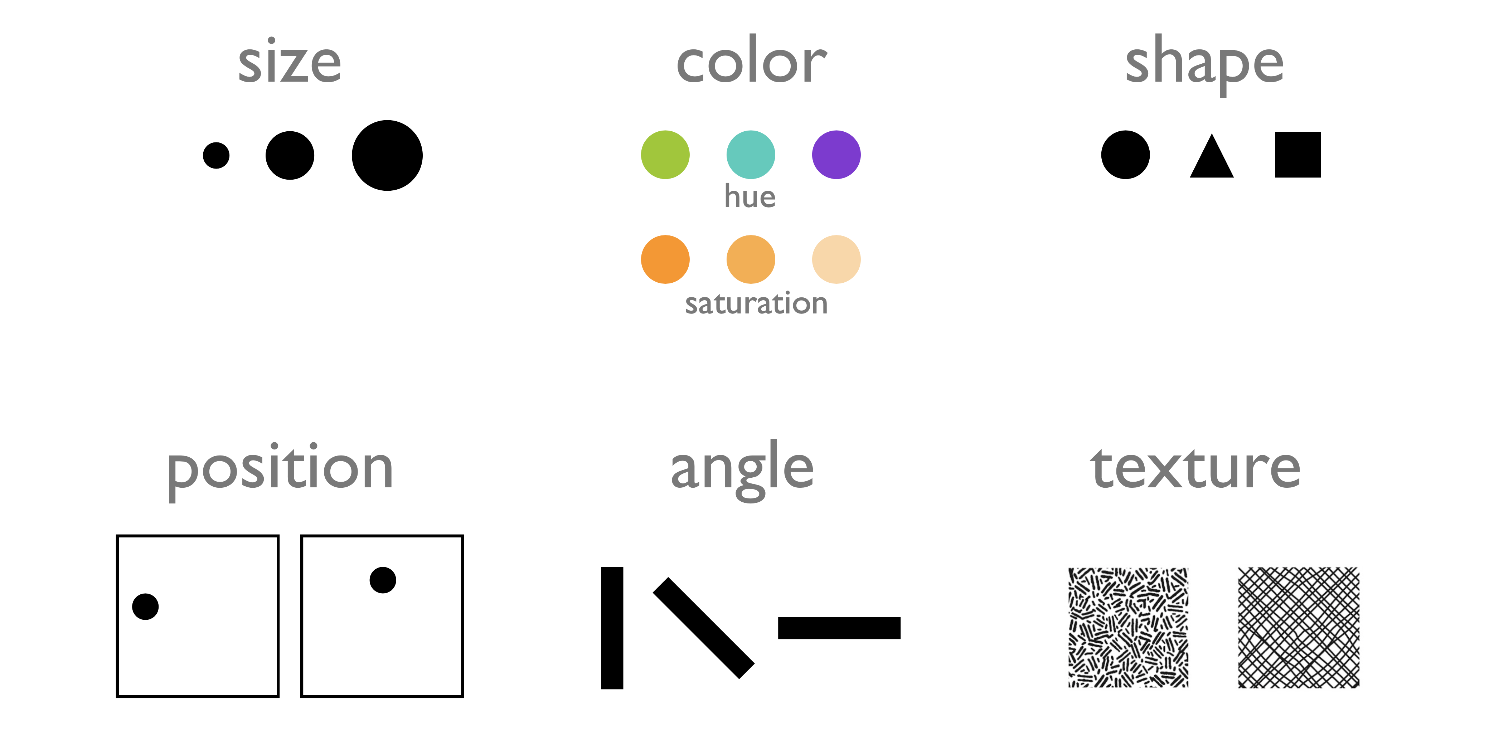
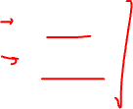
Types of encodings for different data types: Visual Channels (control geometric primitives)
(Credit: Nils Gehlenborg, ISMB/ECCB 2011)

Slide 14
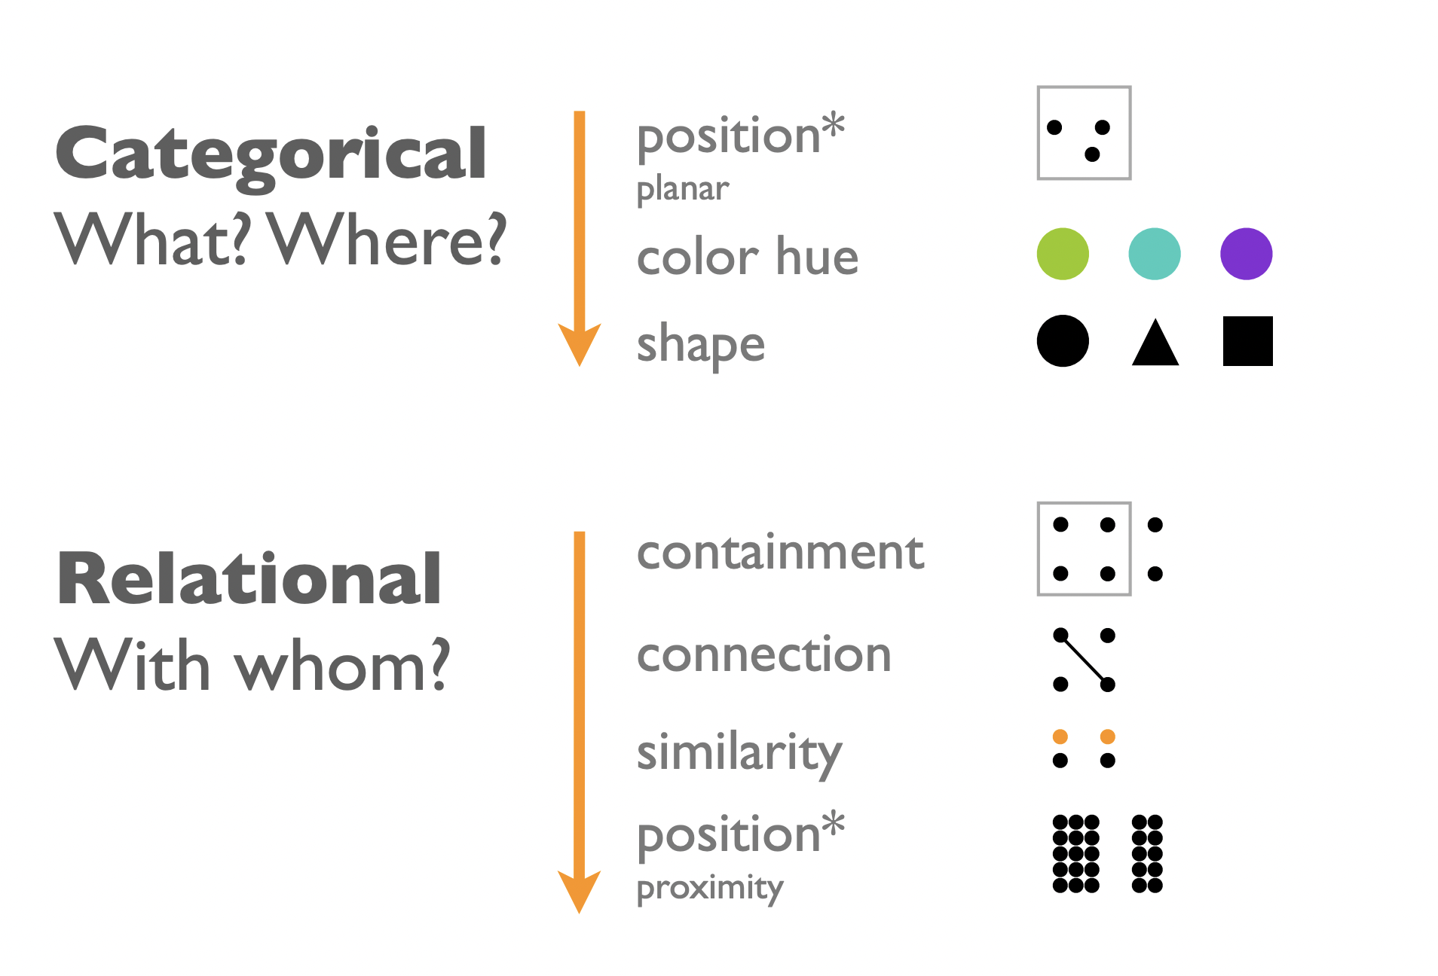
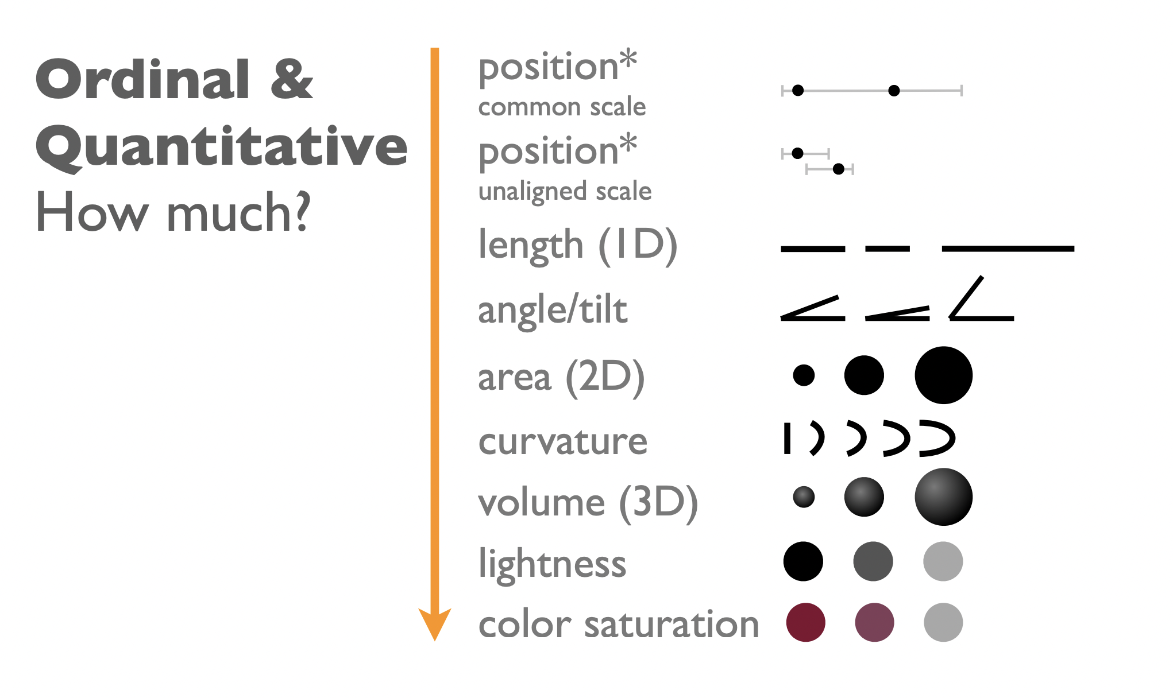

Ranking of Gestalt principles and knowledge about perceptiveness of visual encodings
Better encodings encode more important information more effectively →
data can be read more accurately from some encodings than others

Slide 15
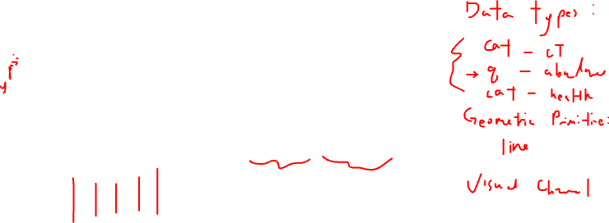
Describing and comparing data visualizations
A
B
abundance
abundance
What are the data types? What are the geometric primitives? What are the visual channels?

Slide 16
Describing and comparing data visualizations
A
B
abundance
abundance
My goal is to make more salient that healthy samples have consistently lower cell-type abundance compared to diseased samples. Which data visualization do you prefer and why?

Slide 17
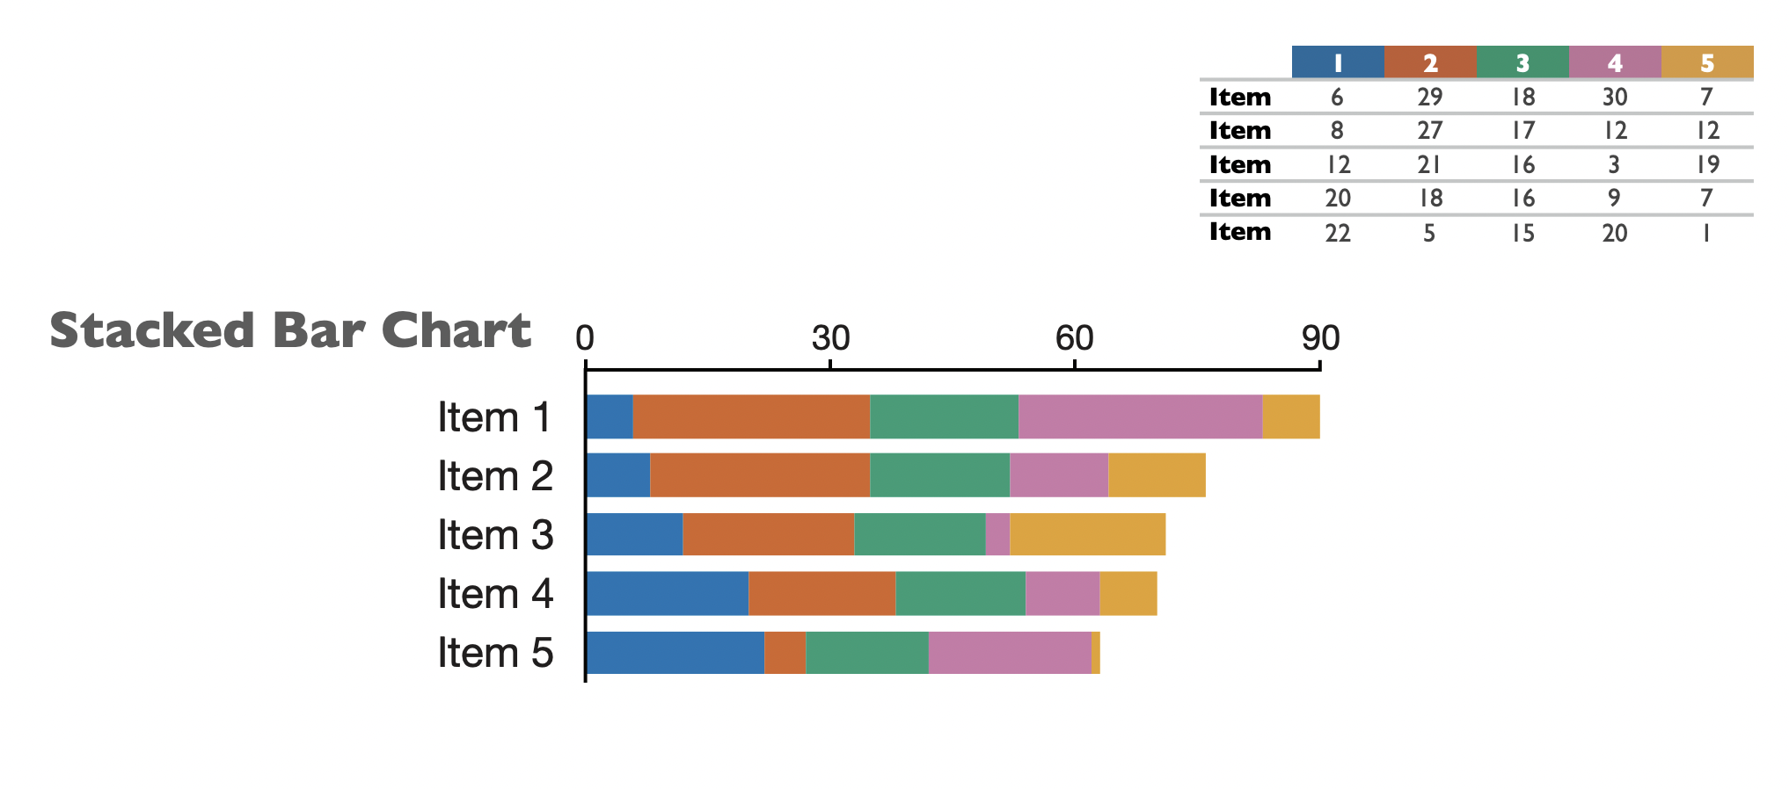
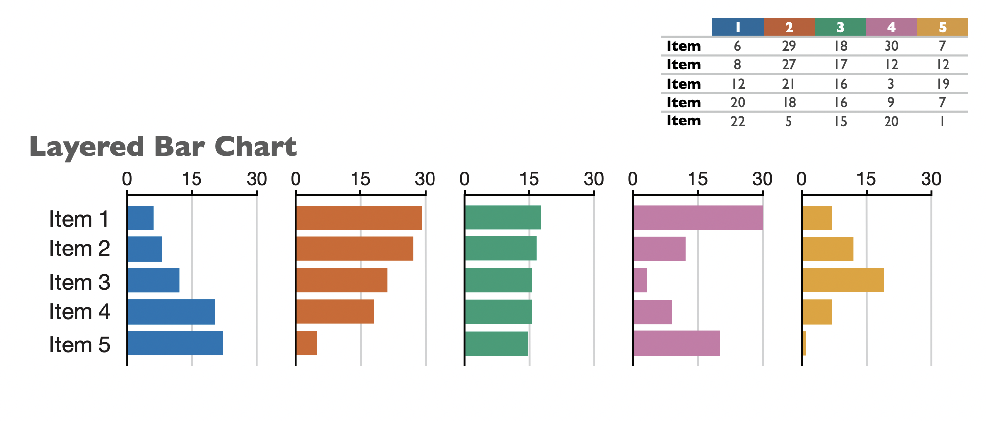
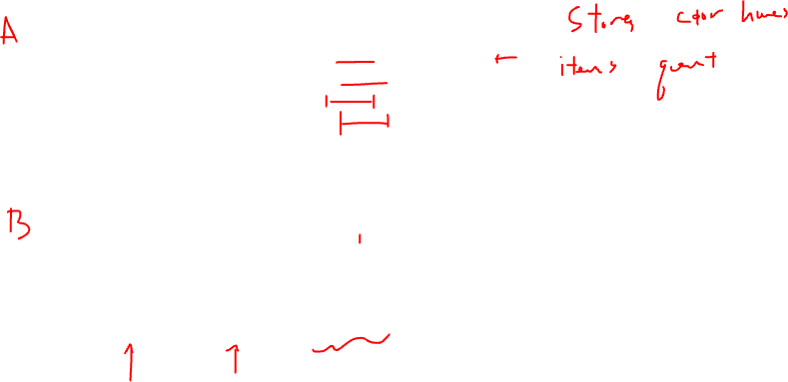
We can make data visualization design choices to make certain features of our data more salient

Slide 18
Spatial transcriptomics by multiplexed smFISH

Slide 19
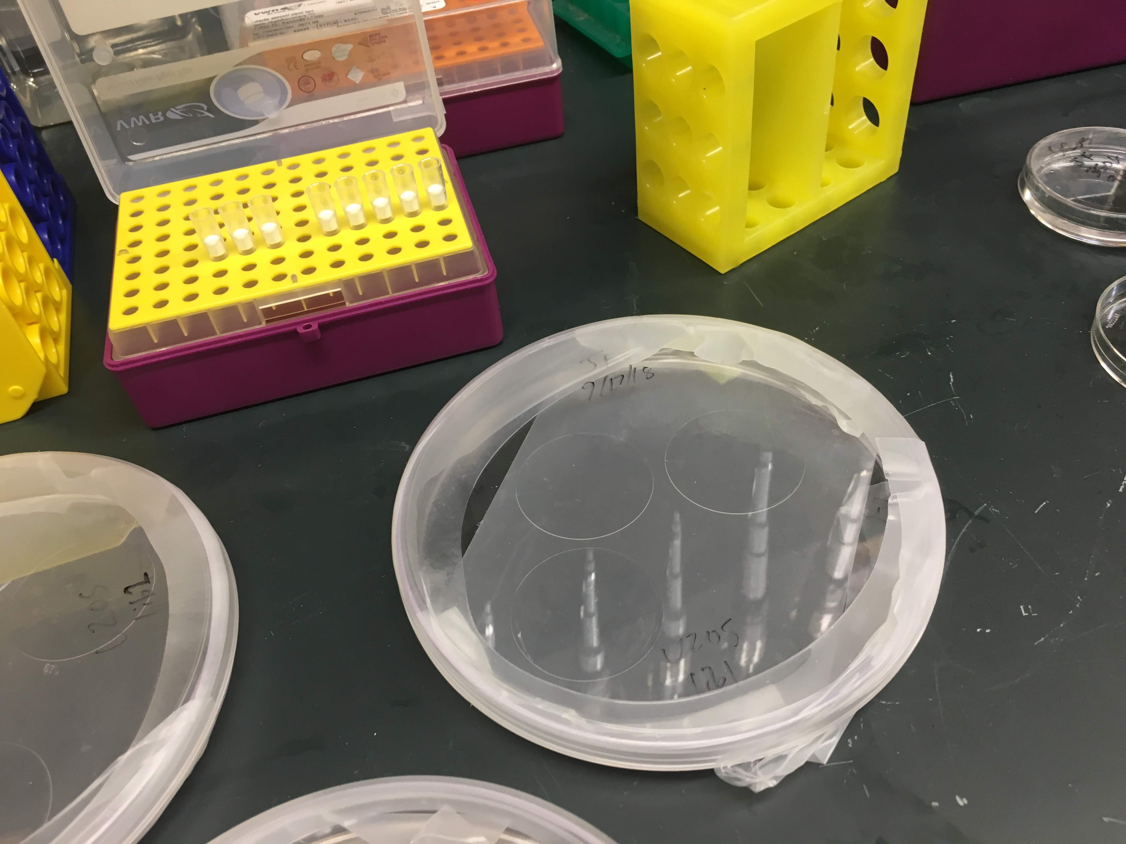
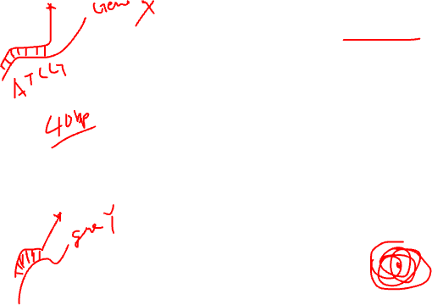
fix cells, hybridize encoding probe @46C over night, wash away unbound probes

Slide 20
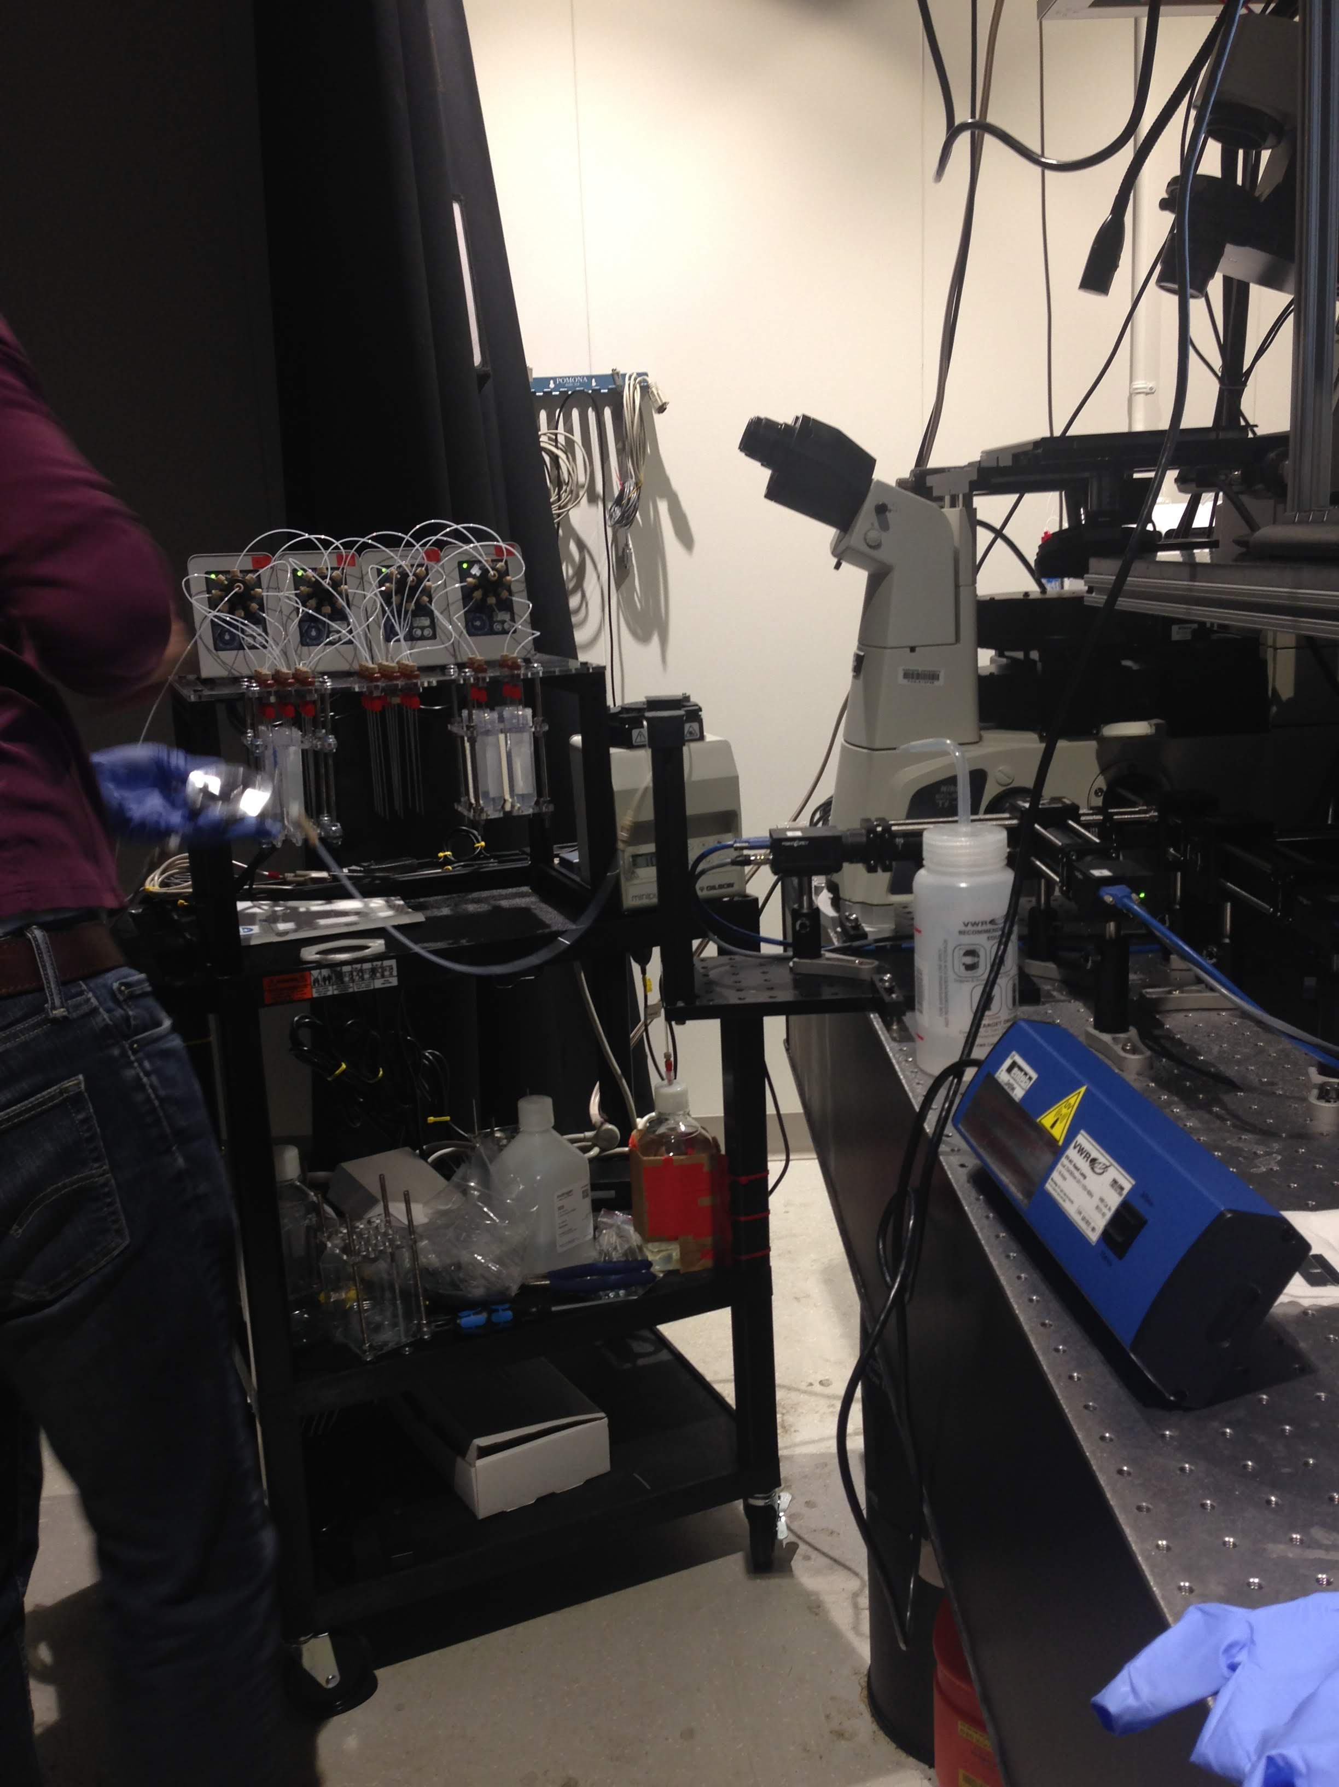
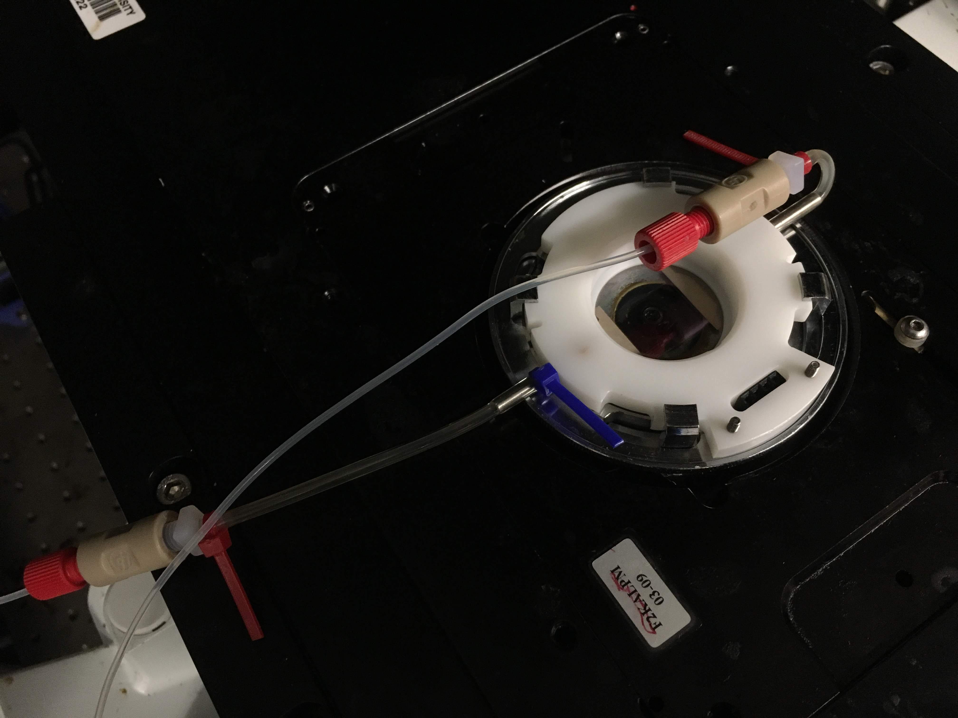
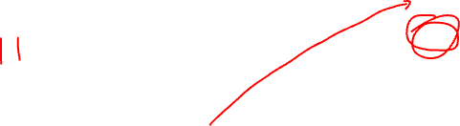
flow on readout probes using microfluidics, wait a few minutes, wash away unbound probes

Slide 21
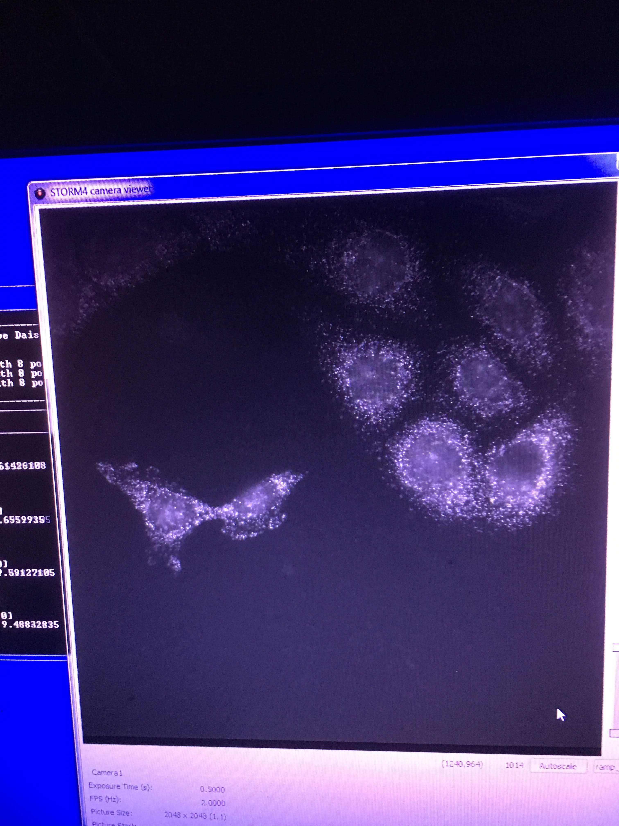
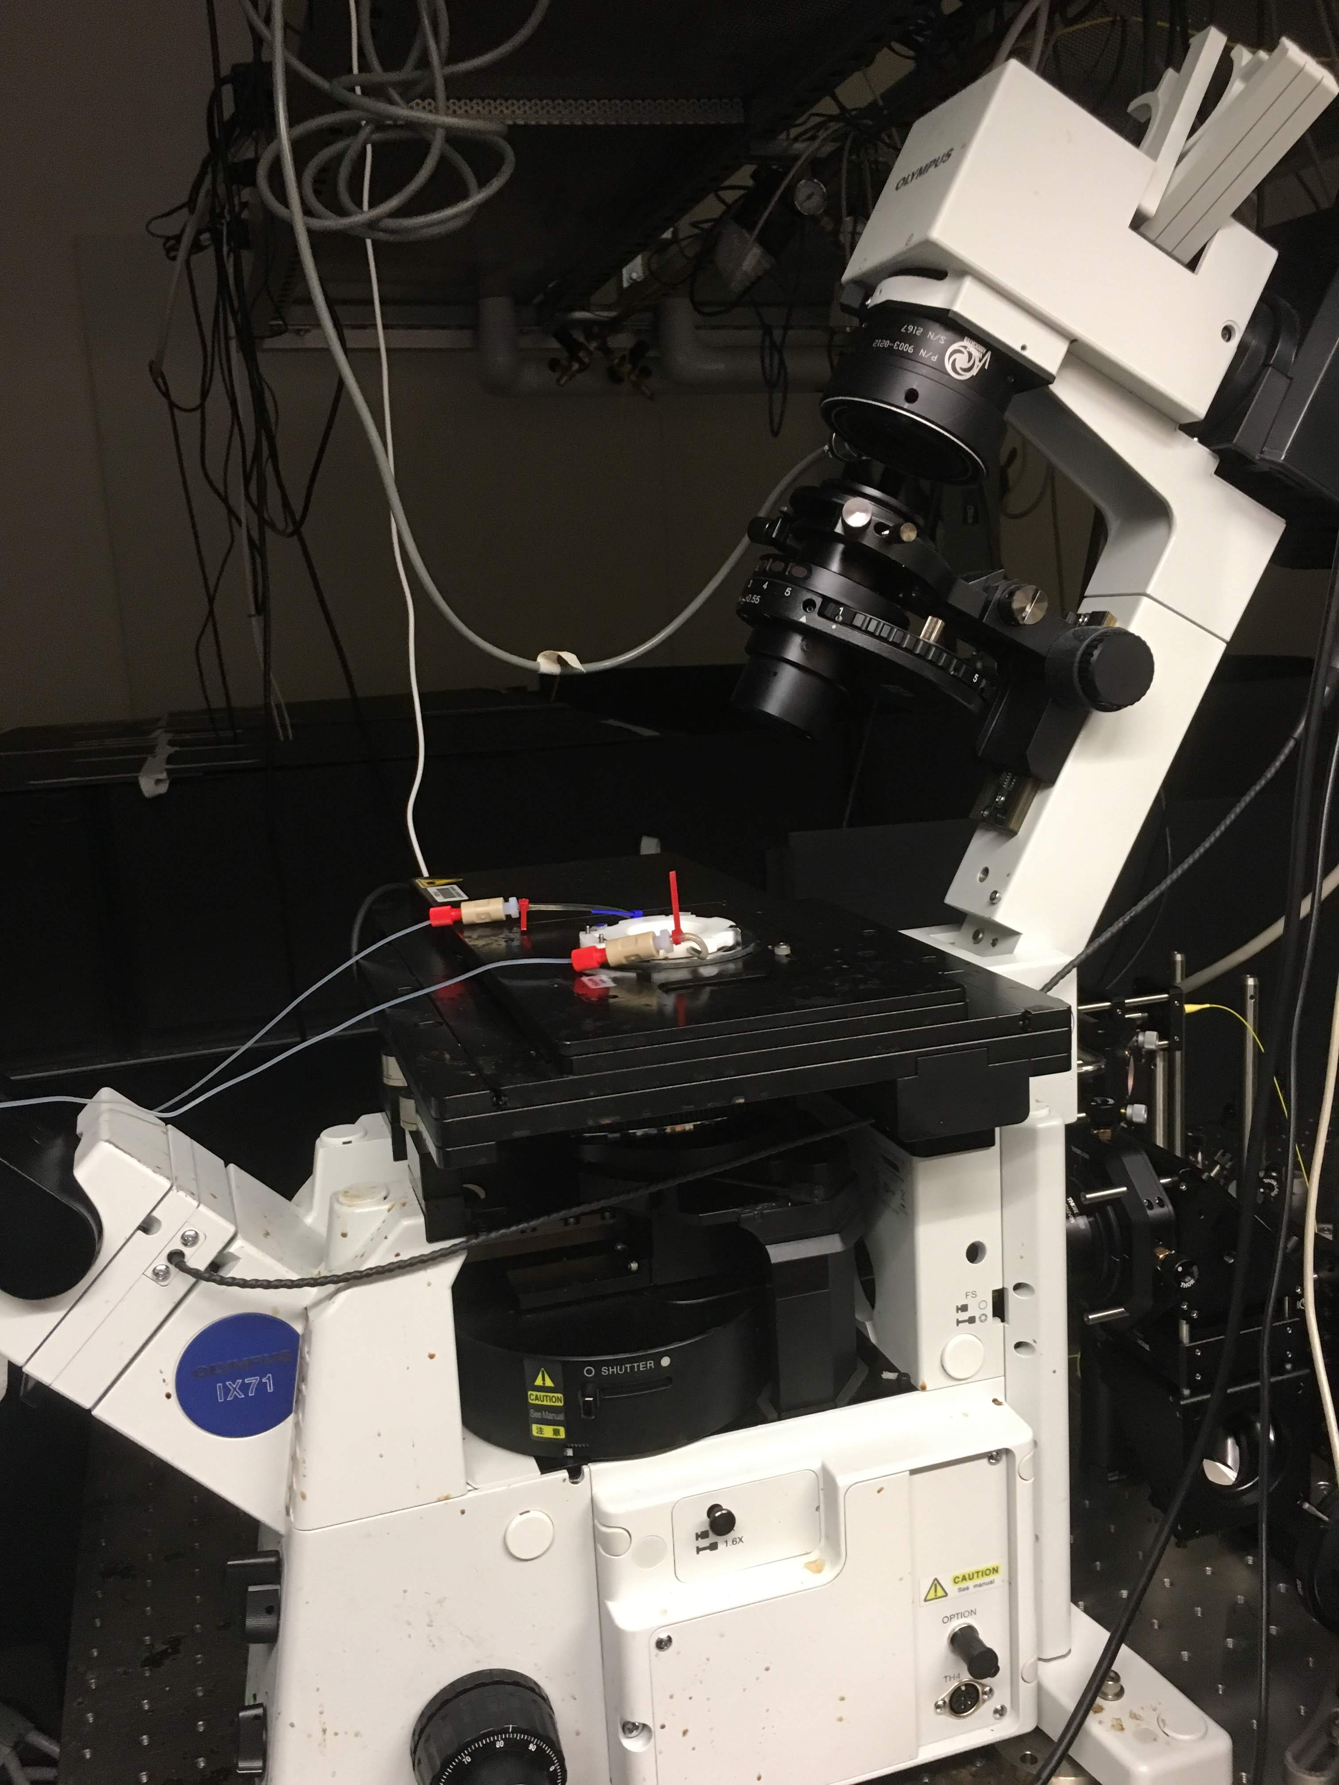

take pictures across many fields of views

Slide 22
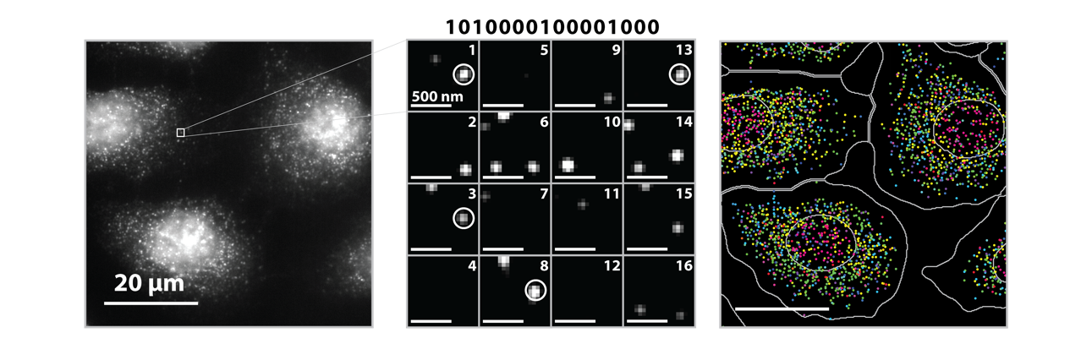
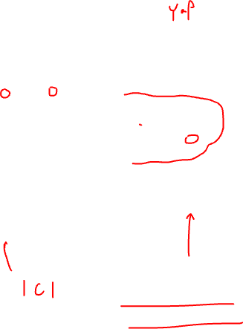
Source: Vizgen, Moffitt lab

Slide 23
Spatial transcriptomics by spatially resolved capture + next-gen sequencing

Slide 24
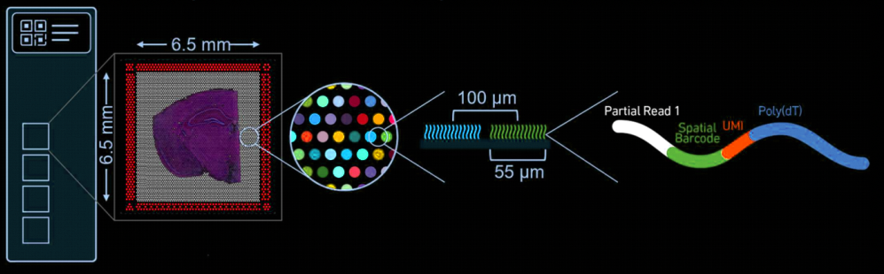
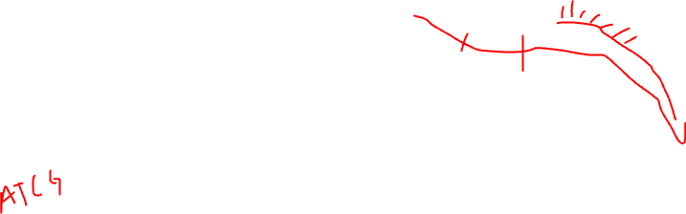
(ST/Visium: Stahl et al, Science 2016)
(SlideSeq: Rodriques et al, Science 2019)
(DbiT-Seq: Liu et al, Cell 2020)
(XYZseq: Lee et al, Science Advances 2021)

Slide 25
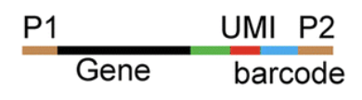
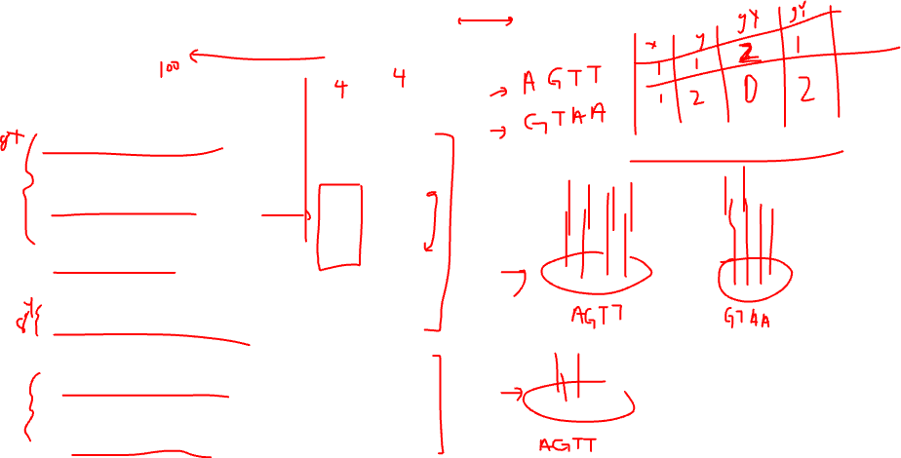
What our data looks like
spatial
barcode
gene
UMI
ATCGGATCGTATAAATGCGTAGCTAGTC----AATG----AGTT
ATCGGATCGTATAAATGCGTAGCTAGTC----TTTG----AGTT
ATCGGATCGTATAAATGCGTAGCTAGTC----TTTG----AGTT
TTGAGTATATGATGAAGATGAAAGGAT----AGGT----AGTT
TTGAGTATATGATGAAGATGAAAGGAT----ATTG----GTAA
TTGAGTATATGATGAAGATGAAAGGAT----GATA----GTAA
…
…

Slide 26
Any other questions?

